Slide 1
ILLINOIS INSTITUTE OF TECHNOLOGY Introduction to 1st Order and Convex Optimization Methods in Linear Programming application Nathan Cao (MSC-514) Professor Priyanka Sharma April 8th, 2021

Slide 2
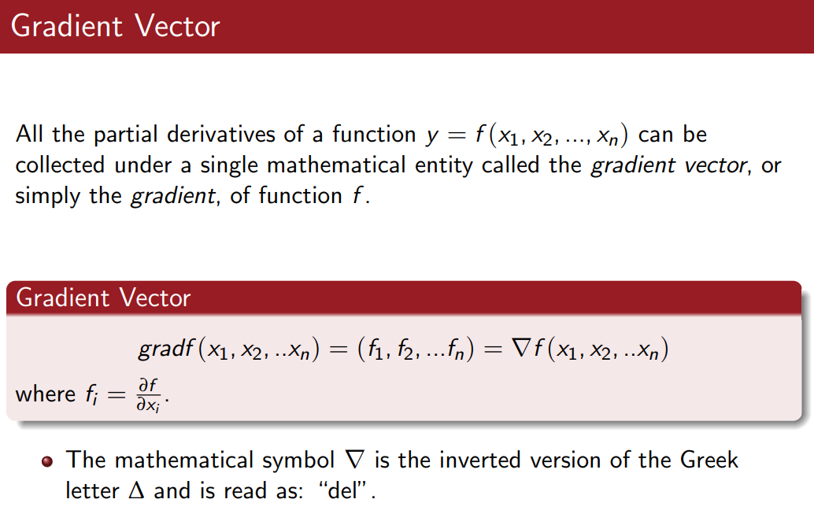
First order and second order optimization application
Firstly, review of optimization knowledge learnt from last semester – Gradient Vector

Slide 3
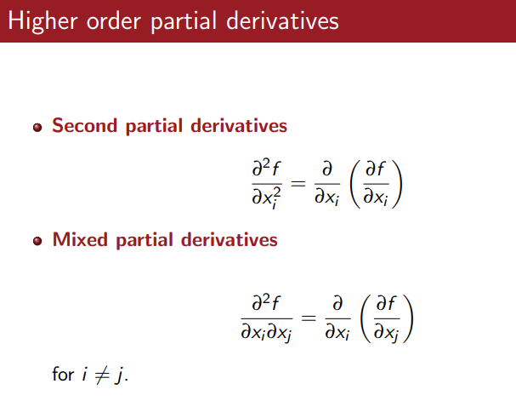
First order and second order optimization application
Firstly, review of optimization knowledge learnt from last semester
- Higher Order derivatives

Slide 4
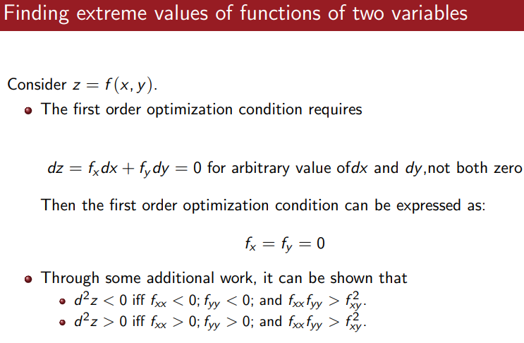
First order and second order optimization application
Firstly, review of optimization knowledge learnt from last semester
- Extreme value: optimal maximizer, minimizer or inflection point

Slide 5
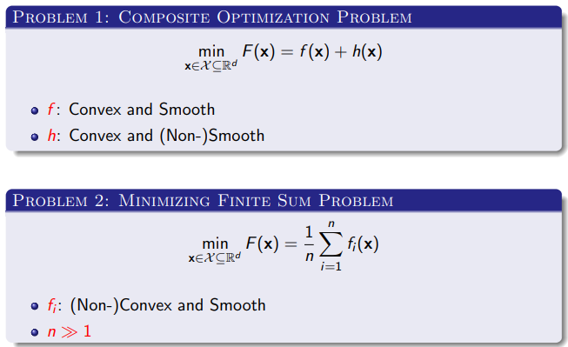
First order and second order optimization application
In practical operation use cases, we usually ask how to calculate minimum or maximum value given a series of inputs, these inputs can be serial and/or stochastic

Slide 6
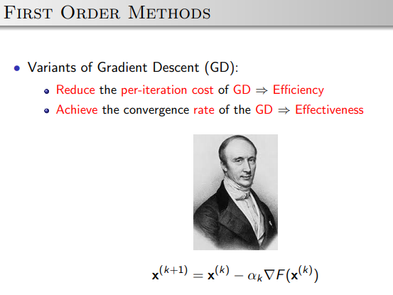

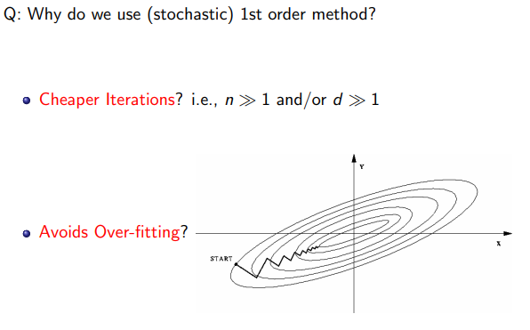
First order and second order optimization application
To solve optimization question, start with first order and second order optimization technologies are good options.

Slide 7
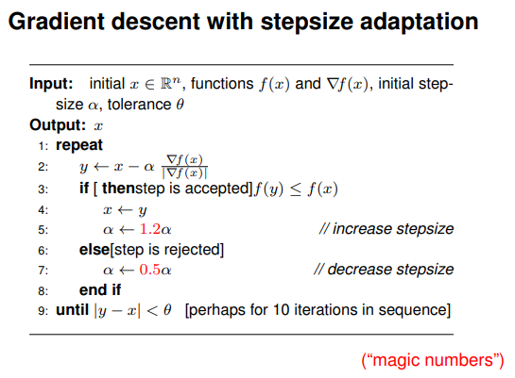

First order and second order optimization application
1st Order method & Pseudo algorithm
There are several methods:
- Plain gradient descent with adaptive step size
- Steepest descent
- Conjugate gradient
- Rprop (heuristic)
In this project submission, using plain gradient descent as example

Slide 8
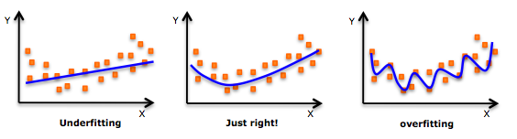
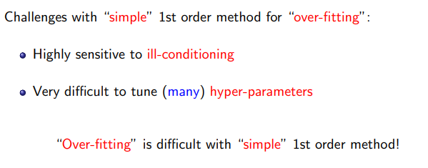
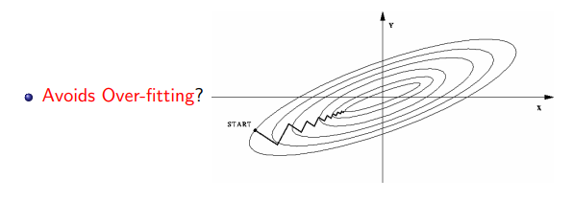
First order and second order optimization application
1st Order method and Overfitting
In designing optimization algorithm, we do pursue a goodness of fit so that a set of observations are fitted
But simple 1st order method can not achieve when having following challenges

Slide 9
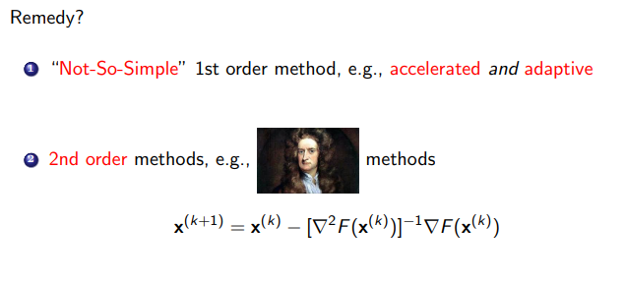
First order and second order optimization application
There are several 2nd order methods:
- Newton
- Gauss-newton
- Quasi-Newton

Slide 10
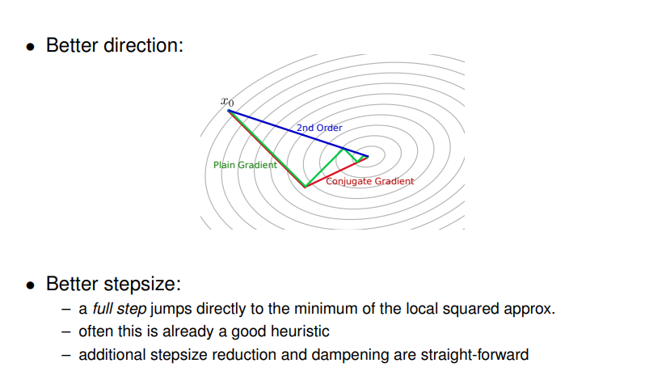
First order and second order optimization application
2nd order algorithm advantage
1st Order

Slide 11
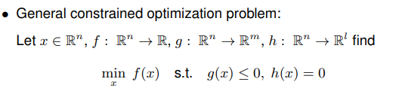
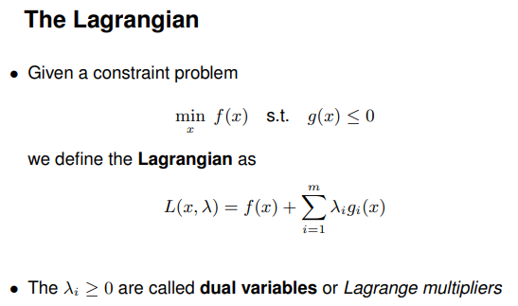
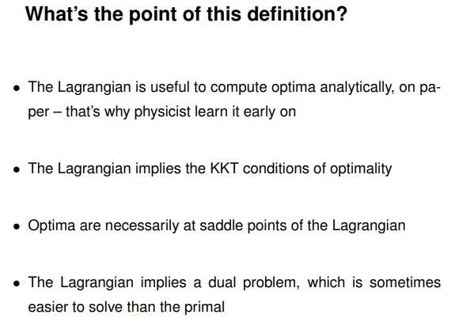
First order and second order optimization application
Before 2nd order optimization methods,
Let’s review the constrained optimization (Lagrangian we already familiar with )

Slide 12
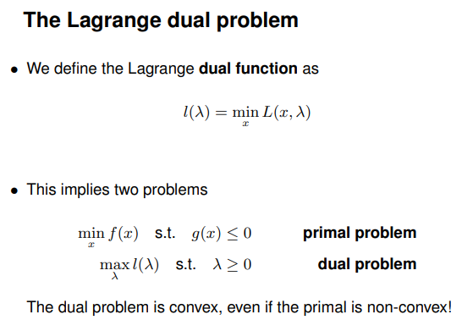
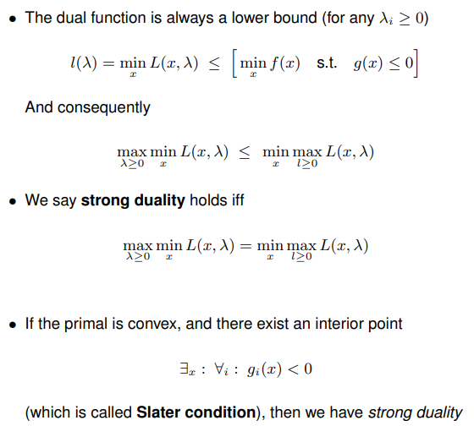
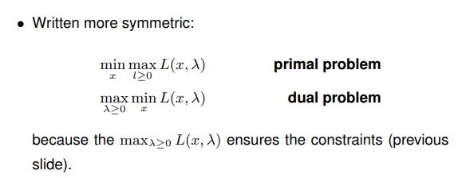
First order and second order optimization application
Before deep dive into 2nd order optimization methods
Let’s recap constrained optimization (Lagrangian we are familiar with )

Slide 13
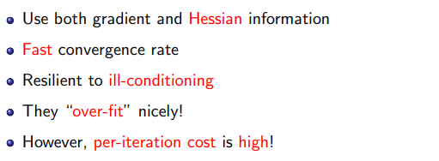
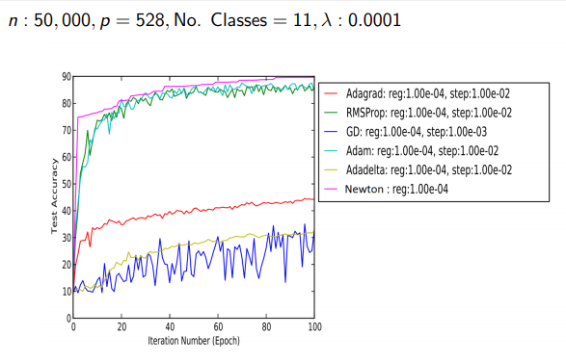
First order and second order optimization application
2nd order optimization methods features:

Slide 14
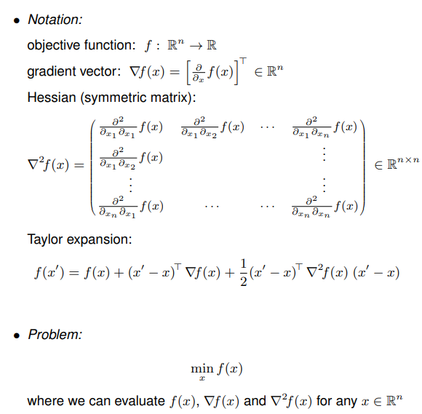
First order and second order optimization application
2nd order optimization methods features:

Slide 15
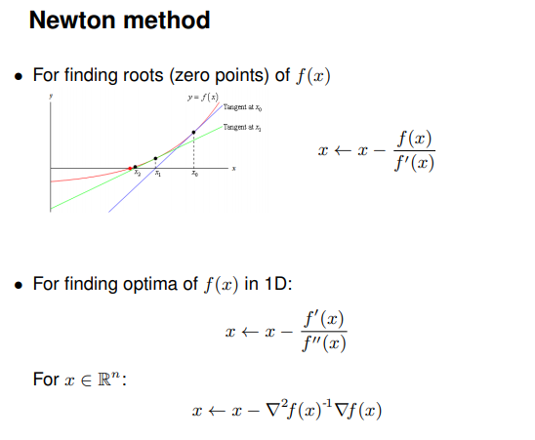
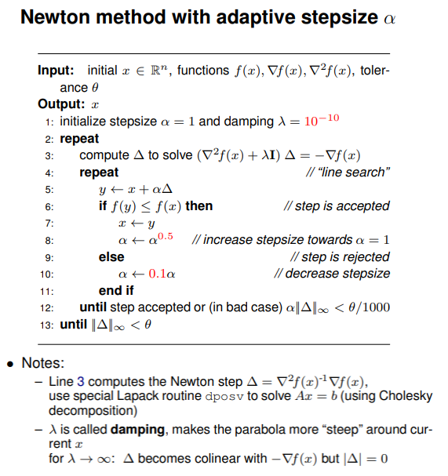
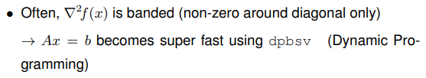
First order and second order optimization application
2nd order optimization methods
- Newton method & Pseudo algorithm

Slide 16
Case study: Classic Portfolio Optimization

Slide 17
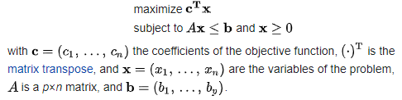
We are interested to see how linear programming for first order optimization applications in industry are utilized and mathematically formulated.
Firstly, let me introduce Simplex, it operates on linear programs in the following form:

Slide 18
Classic Portfolio Optimization
Given Total carrying cash: 1 million dollars on hand
Then we decide to hold stock portfolio with m stocks to choose and allocate to portfolio
Objective: Max(return) and Min(risk), where min(risk) = Max(-risk)
Decision variables:
w1, w2, ….w_{m}: w is the percentage of cash to be allocated to m options of stocks, w has domain in range of 0 to 1, summation of w = 100%
Objective function:
Minimize (-return + lambda*risk), where lambda: a control variable which maintaining weighted average of return and risk, i.e. lambda increasing(decreasing) ➔ emphasis on return(risk)

Slide 19
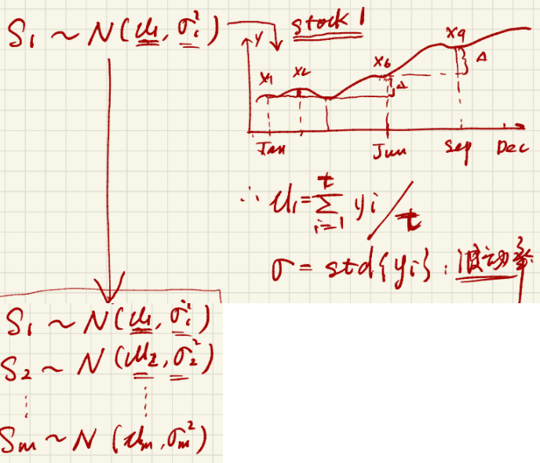
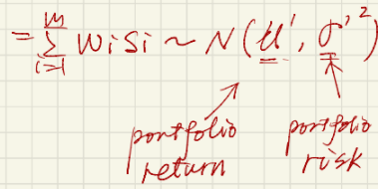
Classic Portfolio Optimization
We incorporate the Random variables: Si, Si is assumed to follow normal distribution ~N(average return, risk_i^2), To be more specific, here is the examples for Si:
S1 ~ N(U_1, sigma_1^2)
U_1: 1/t*summation(y1) in period of t
sigma_1 = standard deviation (y1) in period of t
(Fig 1.1 illustration of random variables)
Therefore, the summation of applied weighted stock times stock distribution also follows Gaussian Distribution:

Slide 20
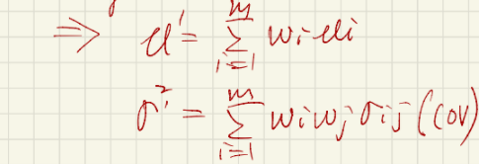
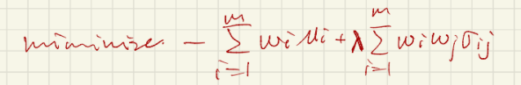
Classic Portfolio Optimization
Where the gaussian distribution for both return and risk can be formatted as:
Now we can reformat the Objective Function as:

Slide 21
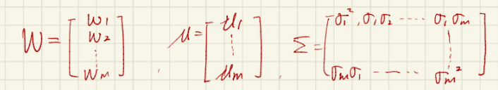
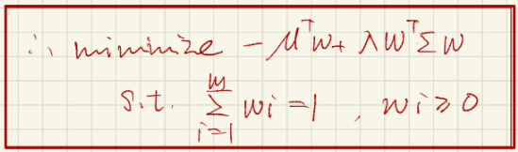
Classic Portfolio Optimization
The algebra matrix per each variable are as following:
Then we successfully transformed our original objective function to be:

Slide 22
Classic Portfolio Optimization
Conclusion:
Lastly, our goal is just to prove this problem is convex program so that we can apply linear programming to find the optimal, this is apparent that the domain of variables set and convex set, and the objective function we defined is quadratic, so it is also convex.
Therefore, based on above justification, we can include that this portfolio program can be solved using linear programming as it follows all convex optimization principles.

